Slide 1
Expanding English Learner (EL)
Access to Specialized Programs
Council of Great City Schools Fall Conference
October 2023
Jaimie Cogua, Coordinator
English Learner, Dual Language, Refugee and Migrant Education
jaimie.cogua@ops.org
Beth Maloney, Ed.D.,Teaching and Learning Consultant
Advanced Academics and Gifted and Talented Education
elizabeth.maloney@ops.org
Notes:
Share Progress toward ID more ELs for GATE
Collaboration with NDE and National Center for Gifted Research
Participant input for ways to increase id of ELs in GATE and support EL enrollment in advanced academics
BIRE 2023
Wednesday May 3
10:30-11:30 a.m.

Slide 2
Session Goals
Share Omaha Public School's work to increase the number of ELs identified for gifted and talented education and participation in advanced academics.
Provide considerations for efficient systems and professional learning to achieve our goal of expanding EL access to specialized programs.

Slide 3
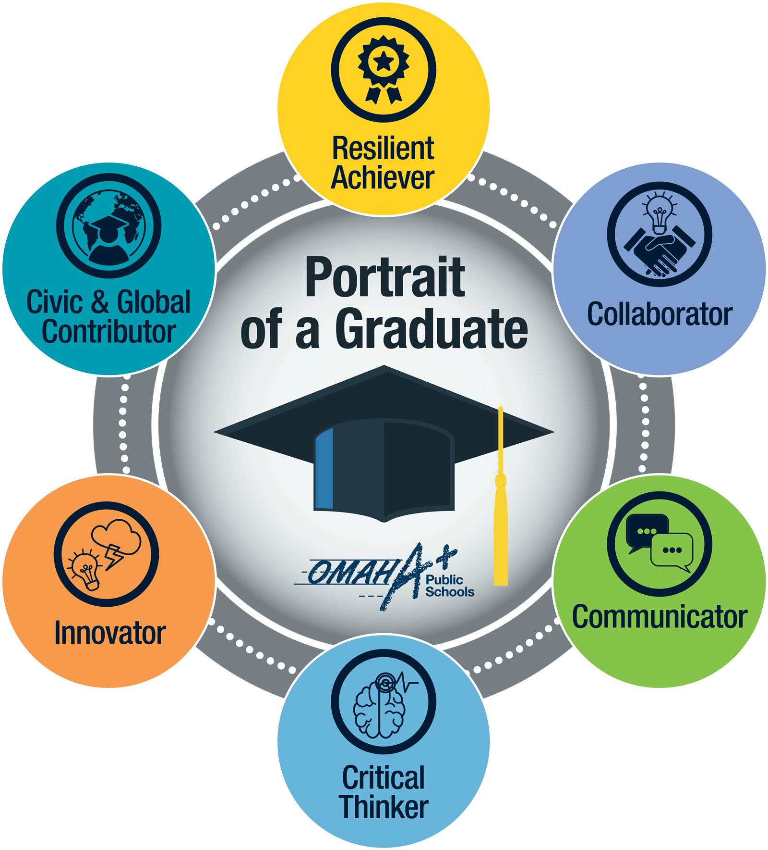
Omaha Public Schools Context
English Learner, Dual Language, Refugee & Migrant Education
Programs
Expanding access for all students
Gifted & Talented Education and Advanced Academics
Notes:
Jaimie (30 seconds)
The Omaha Public Schools is focused on expanding access for all students through collaboration across multiple departments and disciplines.
One of our core values in Omaha is JOY. It has been a joy to bring collaboration to life through our daily work in our district, and today to be able to share with you about our specific collaboration between EL and Gifted and Talented.
In May of 2023, we had the opportunity to share about our work at the Bilingual, Immigrant, Refugee Education Directors meeting. This is an update of our progress in this collaborative work.

Slide 4
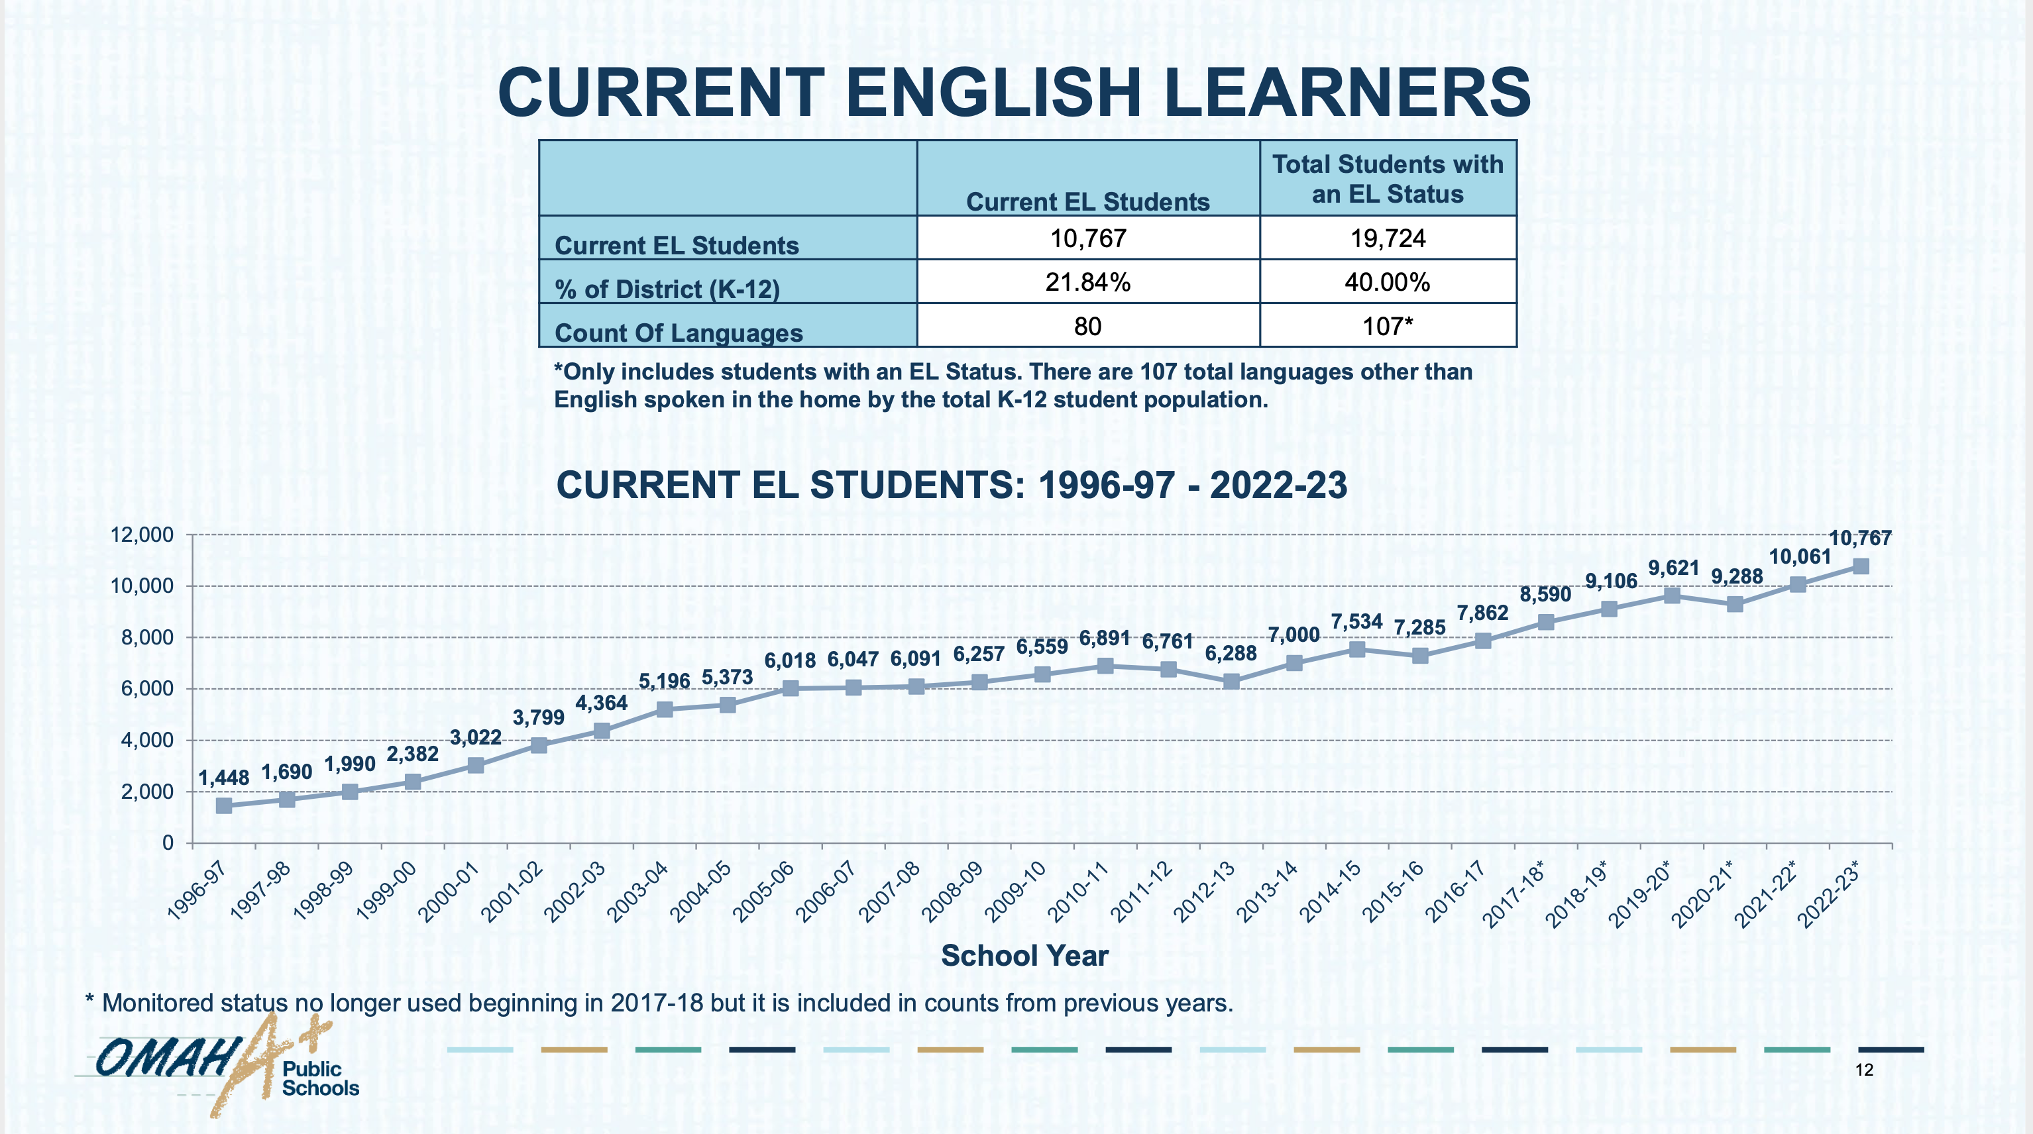
Fall 2023
11,758
23.63%
Notes:
Jaimie (15 seconds)
Similar to your districts, the Omaha Public Schools has seen continual real growth in EL numbers, reaching nearly 12,000 current ELs this year. This represents over 23% of our total district.

Slide 5
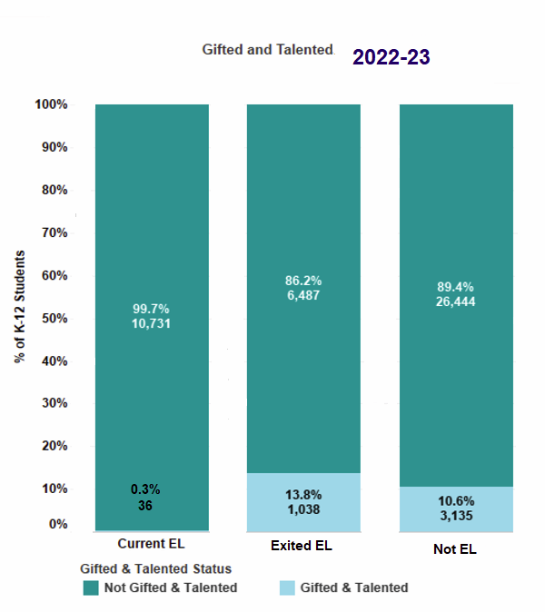

K-12
Gifted and Talented Education (GATE) by EL Status
Current ELs .3%
Exited ELs 13.8%
Non-ELs 10.6%
Notes:
Jaimie (1 minute)
Despite this growth in EL numbers, identification of ELs for gifted and talented education has remained less than 1% since at least 2019. We want to get closer to the goal of 10% of current EL group identified for gifted and talented services to align with the state of Nebraska’s goal of 10% of the overall population identified.
This graph shows groups of students in the Omaha Public Schools identified as gifted and talented.
Worth noting is that the percentage of exited ELs is about 3.2% higher that non-ELs. So, students who are exiting the program are more often identified for gifted education services than non-ELs.
We want to move forward with intentionality to discover how we can recognize the assets our multilingual learners bring and we have been exploring rate of learning a new language as an indicator of giftedness.

Slide 6


Advanced Academics Overview
GATE Facilitator available for consultation
Second Grade Whole Class GATE Lessons
GATE Sponsored Events
Honors Special Projects
Honors Courses
AP Capstone
Cambridge International
International Baccalaureate
Primary Grades
Middle School
Advanced Diploma
Upper Elementary
High School
GATE Specialized Instruction
Fermi Mathematics
Reading Olympics
Honors Courses
IGCSE Cambridge Courses
Pre-IB Courses
Notes:
Beth (2 minute)
As we mentioned, we are very focused on expanding access to advanced academics for all students. We have worked to define a continuum of Advanced Academic services from kindergarten through 12th grade. This slide highlights the advanced academics opportunities at each level. With the exception of Gifted and Talented specialized instruction, every opportunity on this graphic is available to every student.
An important addition to our services has been whole class lessons in all 2nd grade classrooms that elicit high levels of student thinking to help classroom teachers in talent spotting. 2nd grade teachers are integral to the initial identification of students for gifted and talented services.
Official GATE identification begins in 3rd grade, and we continuously monitor students throughout 8th grade for possible participation in gifted and talented services.
At the secondary level, we have updated our advanced academic placement guidelines to helps schools think differently about course placement to expand access to advanced academics and ensure students are able to enroll in the courses of their choice, therefore further opening the door for all students to participate.
The following statement is prominent on all placement guidelines: *Students develop cognitively, socially and emotionally along different time and interest continuums. For students who are willing and interested in advanced coursework, but do not meet the course prerequisites, an exception may be requested through a conversation involving building staff, parents/guardians, and the student.
Beginning this school year, all 9th grade students in our Cambridge International buildings take 9th grade ELA and US History courses that are taught using the Cambridge syllabus. Our intent is to help all of our students feel confident in their ability to continue taking additional Cambridge courses which are part of our advanced acedmics.
As we roll out the Advanced Academic Diploma programs in each of our high schools, the messaging will be clear: all students are welcome to pursue advanced academics. We believe in you and we will support you throughout your journey.

Slide 7
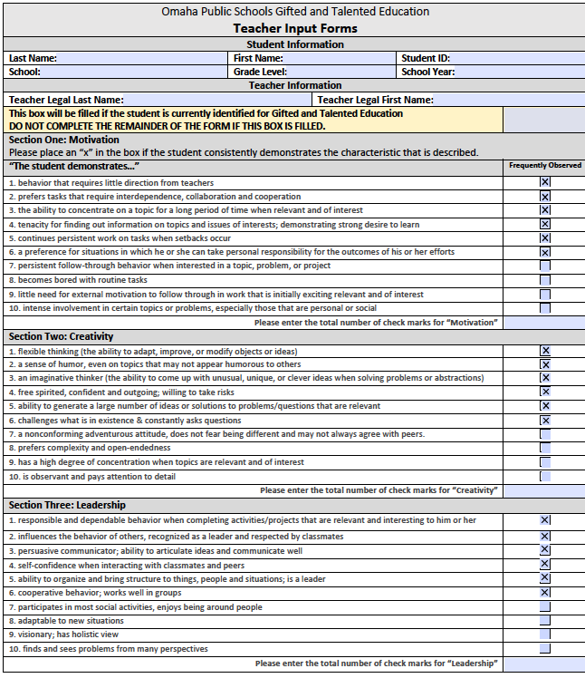
Current GATE Identification Procedures
Targeting ELs
Use of local norms
Academic – MAP Growth
Cognitive ability – InView
ELPA21 On-track for meeting Proficiency
Referral system
Input Forms and Referral Letters
Motivation, Leadership, Creativity
Strategic staffing at high EL schools (DL and non-Dual)
90% completion rate!
Notes:
Beth (1 minute)
Ou current Gifted and Talented identification procedures use multiple criteria to identify students for gifted services. Some of the important features that are designed to identify more students from under-identified populations include use of local norms, our referral system, and strategic staffing.
We calculate local norms for two of our identification criterion: academic achievement and cognitive ability.
We use MAP growth assessment in the areas of reading, math and science. Each of these areas are normed both nationally and locally and are considered a qualifier toward gifted identification.
The cognitive ability test, InView, is broken into verbal and nonverbal tests, which are also normed nationally and locally. We also consider the composite score. However, we do not require a composite score to qualify for gifted services.
The use of local norms helps us to target students who would not typically be identified using national norms.
We have a robust referral system that includes two components, input forms and referral letters. As part of our system, all students in grades 2-4 have an input form completed by the classroom teacher at the end of the school year. The form requires the teacher to evaluate the student in the areas of motivation, leadership and creativity using a checklist of attributes. Each area is given a total score, and a student can qualify with an outstanding score in any of these three areas.
This year, for the first time, this form was housed in our online student database, and the Gifted and talented education teachers supported schools to ensure that teachers were aware of the form. The teacher completion rate was over 90%! We are excited about this because it is evidence that our system is working more efficiently.
We also use a letter referral system that a Parent, Guardian, Student or Staff can complete on behalf of any student in the same areas of motivation, leadership and creativity. The referrals are reviewed each quarter, and a rubric is used to determine whether the student meets the criteria. The referral is also considered a qualifier toward gifted identification. We have these available on our district website so that any community member can access the form.
Finally, we have been strategic in staffing gifted positions. We intentionally looked to hire staff at schools with high EL populations that have skills and background that support the goal of expanding access. Qualities we looked for were multilingual skill-set and a mindset focus on talent development and talent spotting.
Possible questions:
How are you scoring these?
Prepare to share input form and referral letter (PDF)

Slide 8
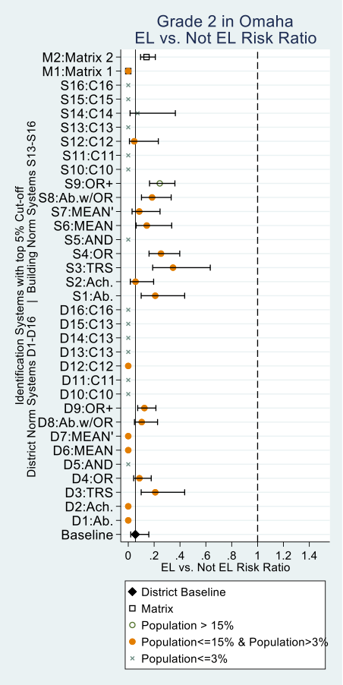
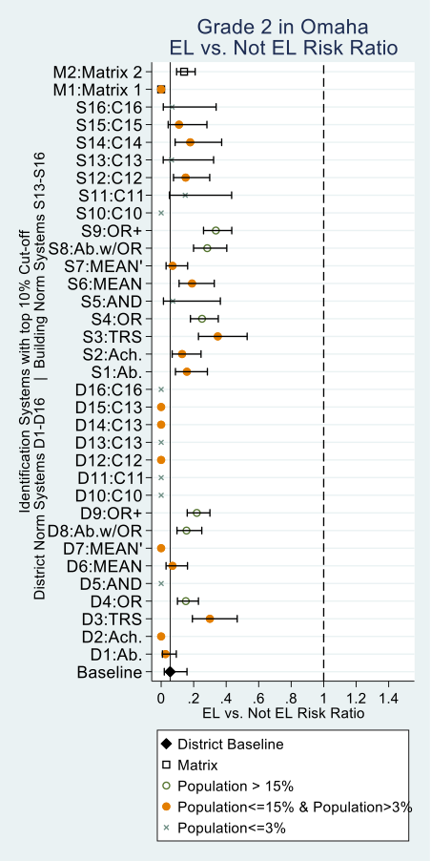
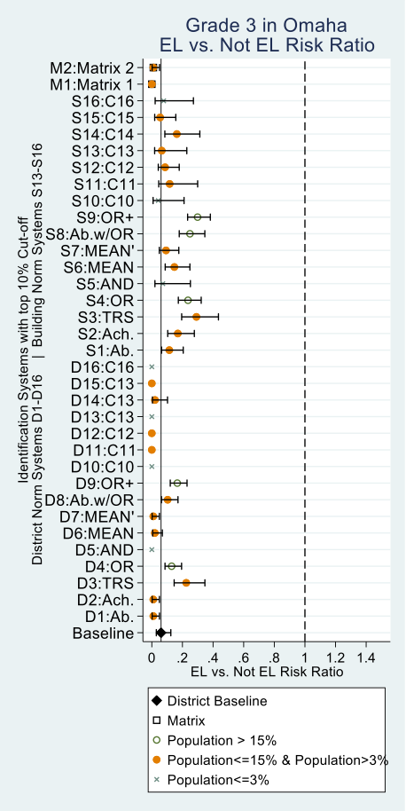
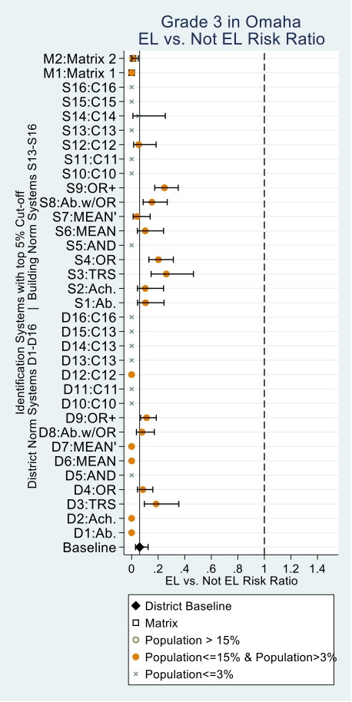
National Center for Gifted Research
Graphs of 64 Combination Rules for Omaha for 2nd Grade
No matter what you choose, none of these factors get closer to parity with the desired ratio.
What's the point?
.2 = 1/5 of a chance .5 = half as likely
to be identified for Gifted services if you are an EL
Graphs of 64 Combination Rules for Omaha for 3rd Grade
Notes:
Beth (animated slide)
Recently, we embarked on a research study with the National Center for Gifted Research and received the results of this review in June 2023. In our work with the National Center for Gifted Research, Dr. Betsy McCoach has been an excellent partner.
The National Center for Gifted Research analyzed Omaha data to determine how to simplify and strengthen identification systems while simultaneously expanding participation opportunities for underserved students. We hope to better understand how to use multiple measures to identify students as gifted (e.g., teacher ratings, achievement tests, ability tests), and the specific ways in which when these multiple data points are combined, they influence the composition and diversity of the population of identified gifted students. To conduct the study, we needed teacher ratings, achievement, and ability measures for all students in any given grade level.
The Center ran 66 different simulations using the data we provided related to our criteria – none of them were able to get to parity for underrepresented groups using our gifted and talented identification criteria. The goal is to identify students from various groups at a similar rate. In Nebraska, the goal for identification is 10% of the student population at the grade levels where gifted and talented services are offered.
They recently provided us these graphs representing numerous variables that could have the potential to get us to parity with EL identification comparing grade 2 and grade 3 data.
As you look at this, you're probably thinking (click) that's a lot of information "what's the point"? Of all the simulations ran, there was a range of .2 to .5 representing 1/5 to ½ of a chance that as an EL you would be identified for Gifted education.
The bottom line is not great news (click). No matter what you choose, none of these factors get us closer to parity for underrepresented groups like EL with the desired ratio of 1:1.

Slide 9
Teacher Rating Scales
Better but caution
~20% variance in Omaha Public Schools
EL & non-EL identified similar rates
Teacher who rates higher = student more likely to be identified
Notes:
Beth
However,
Teacher rating scales are better but caution... rating is dependent on which teacher completes the rating scale
~20% variance in OPS due to teacher rating
EL & non-EL identified similar rates on teacher rating scale
Impact- student in a classroom with a teacher who rates higher overall is more likely to qualify versus student in a classroom with a teacher with stringent scores
We plan to improve this practice by providing better professional learning for all classroom teachers who will fill out an input form. This training will include general information about gifted and talented students, how to use teacher rating scales, their purpose in our identification system and instruction for accessing the forms. We will emphasize that all students must be considered equally and teachers should not assume that they know who should be identified. We plan to house this training in our Canvas system.

Slide 10
Key Implications
Local norms are better than national norms for parity and equity
Teacher rating scales are most promising practice for equitable identification
Inclusive practices are necessary
Rate of learning as an indicator of giftedness
Notes:
Some of the key implications from the research study and our own observations for identification of underrepresented groups such as ELs are that local norms are better than national norms for parity and equity. The 66 alternative systems that we run using our identification criteria conclude that a Mean rule with a 10% cut-off level and local norms presents a balanced option with higher than average diversity and high average ability.
Teacher rating scales are the most promising practice for equitable identification. The use of teacher rating scales greatly increases our chances of identifying students who would likely be missed in a different identification system.
And inclusive practices are necessary. We must be intentional with our use of inclusive practices and integrate them into our system. We monitor our outputs regularly to ensure that there are not any breakdowns in the system that we have carefully built.
However, we do know that in spite of our efforts, normed test scores still hold us back. English learners are often not able to score well on standardized tests because of their language proficiency level. This is the reason we want to explore the use of ELPA as a criterion for identification with a look at rate of learning a new language as an indicator of giftedness.

Slide 11
Nebraska ELPA On-Track Report
862
92
11
Notes:
Jaimie
Nebraska is an ELPA21 state, and we are fortunate to enjoy positive and collaborative relationship with the Nebraska Department of Education. When we reached out to discuss how we could potentially use the ELPA On-Track report, we learned the state has also had some conversations with districts who want to identify students who move more than one level in a year as one data point in helping to identify high ability learner ELs.
The state has just updated our state ADVISER accountability system to provide a way to more easily compare students’ on-track to meet proficiency performance level from the previous year to this year. The on-track system is designed to measure the expected amount of progress needed to meet proficiency within 6 years when starting at a baseline of emerging year 1.
As we considered this data comparing 2021-22 to 2022-23, we found:
11 students, moved 4 levels
92 students, moved 3 levels
862 students, moved 2 levels
But we needed to know more If we were to consider ELPA21 on-track data as one indicator for potential gifted student identification.
ELPA21 Goal-setting forms

Slide 12

ELs Grades 3-8 at time of 2023-24 Gifted and Talented Services Selection
5,322
24% of total population gr. 3-8
Notes:
The Omaha Public Schools Research department analyzed our data further and found that at the time of gifted and talented services selection for the 2023-24 school year,
About 24% (5,322) of students enrolling in grades three through eight in 2023-24 were EL students at the time of selection.
868 of these ELs met at least one of the GATE selection criteria.
Only 87 or about 10% of the ELs meeting at least one GATE criteria were identified for GATE.
About 146 students met at least one GATE criteria and moved two or more domains on the ELPA21. While some of these students were ultimately identified for GATE, they may have benefited from having the ELPA21 criteria as a part of the identification process. This represents almost 60 students who we may be missing.
So including the ELPA21 in addition to teacher rating scales and our referral system do seem to indicate potential to identify more ELs for gifted and talented services, which reflects our belief that we have many talented multilingual learners in our schools.
GATE Selection Criteria Explanation
Students in grade three can meet four criteria for GATE recommendation and must meet three of four criteria to qualify. These include cognitive, achievement, motivation and/or performance, and creativity and/or leadership metrics.
Students in grades four and five can meet three criteria for GATE recommendation and must meet two of three criteria to qualify. These include achievement, motivation and/or performance, and creativity and/or leadership metrics.
Students in grades six through eight can meet three criteria for GATE recommendation and must meet two of three criteria to qualify. These include achievement and performance (GPA) metrics. Teacher input forms are not completed for students going into grades six through eight.

Slide 13

Key Learnings
Collaboration has accelerated systems improvement
"Missingness" must be explicitly addressed
Create efficient systems for data
Systematize professional learning
Notes:
Jaimie
We've just touched the tip of the iceberg for the introductory data that we have received from the National Center for Gifted Research and the work that needs to be done
Some key learnings that will guide our next steps and may apply to your context are:
Collaboration has accelerated systems improvement in working toward our shared goal of increasing the number of ELs identified for gifted and talented education and participating in advanced academics
The concept of “missingness” – students who are underrepresented - must be explicitly addressed by school leaders
Create efficient systems for rating scales and data collection so we don't add additional burden to school staff through this process
Systematize professional learning for iterative reminders to all staff to increase consistency and reduce bias in referral rating
Multilingual Learner Fall Conference includes a specific session Gifted and Talented Multilingual Learners by a national presenter.
EL extended learning through an accelerated, enrichment experiences tied to STEAM.
ELPA21 Goal-setting forms
How can we monitor the number of ELs taking advanced academic courses?

Slide 14
Thank you.
Jaimie Cogua, Coordinator
English Learner, Dual Language, Refugee and Migrant Education
jaimie.cogua@ops.org
Beth Maloney, Ed.D., Teaching and Learning Consultant
Advanced Academics and Gifted and Talented Education
elizabeth.maloney@ops.org

